Slide 1
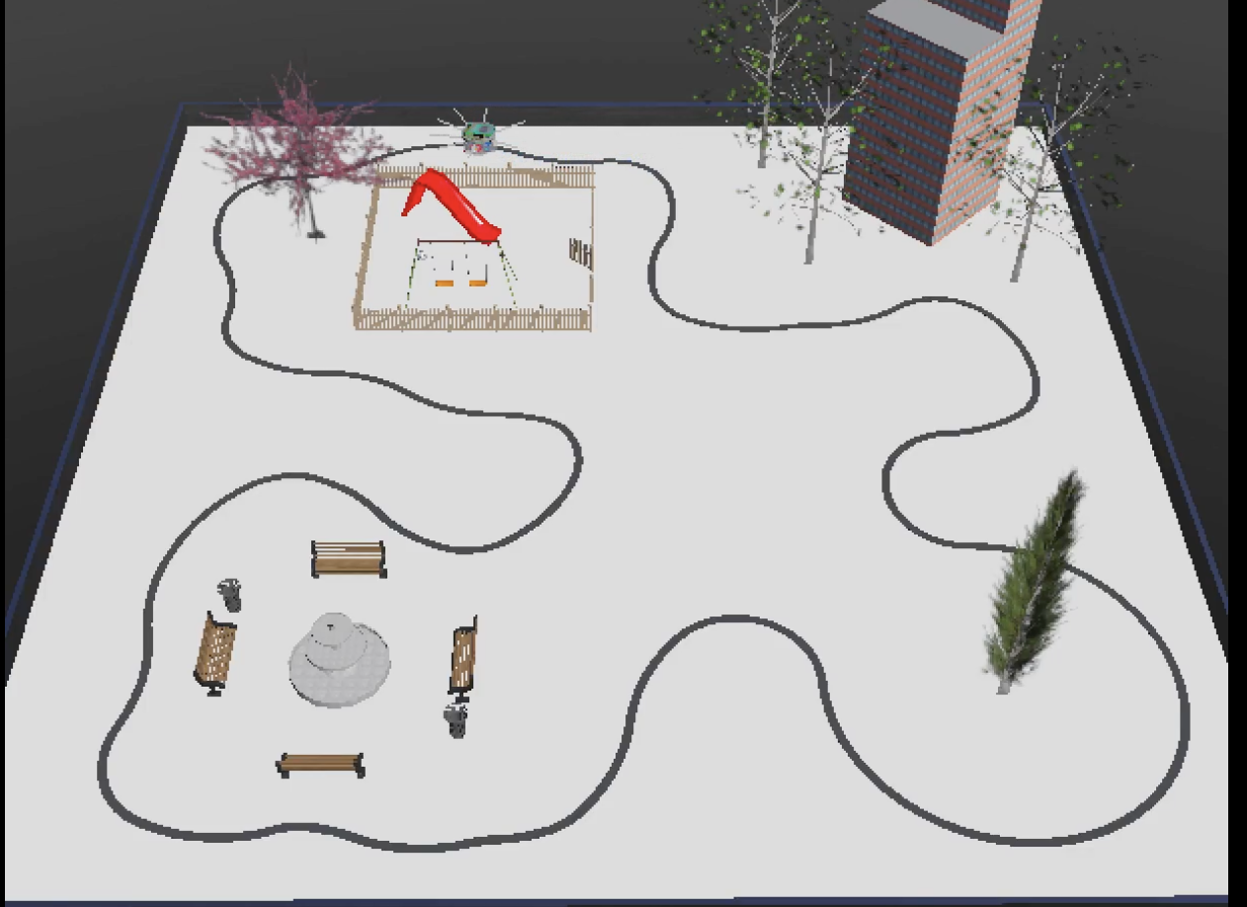
Follow the line -robot with Webots
Nasra Diriye & Sara Salim
University of Eastern Finland

Slide 2
Why did we choose this topic?
Easy to learn and build
Interesting concept applied in real-world applications
Simple design with opportunities for advancements

Slide 3
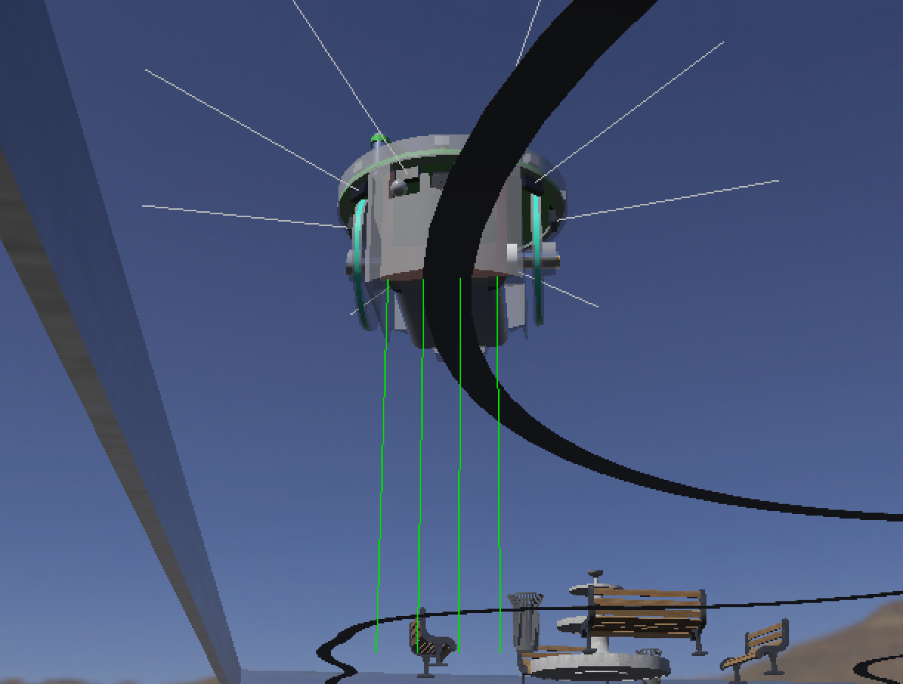
Technical implementation
Webots application
The simulation environment
Tinkercad
Self-designed 3D model as track line
E-puck –robot
Infrared sensors
Python
PID algorithm

Slide 4
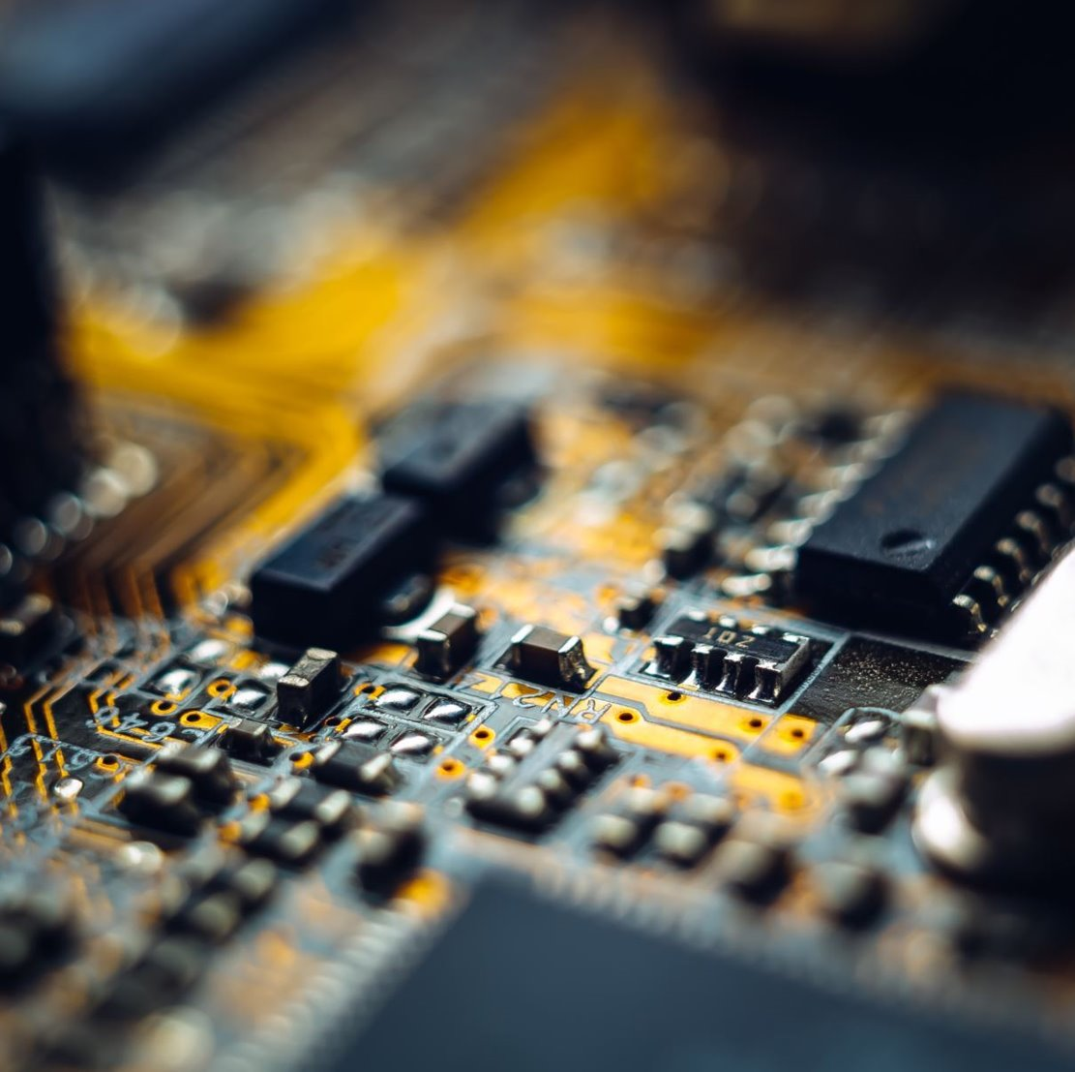
Achievements
A robot that follows a predefined path
Independency of the robot
Speed and accuracy

Slide 5
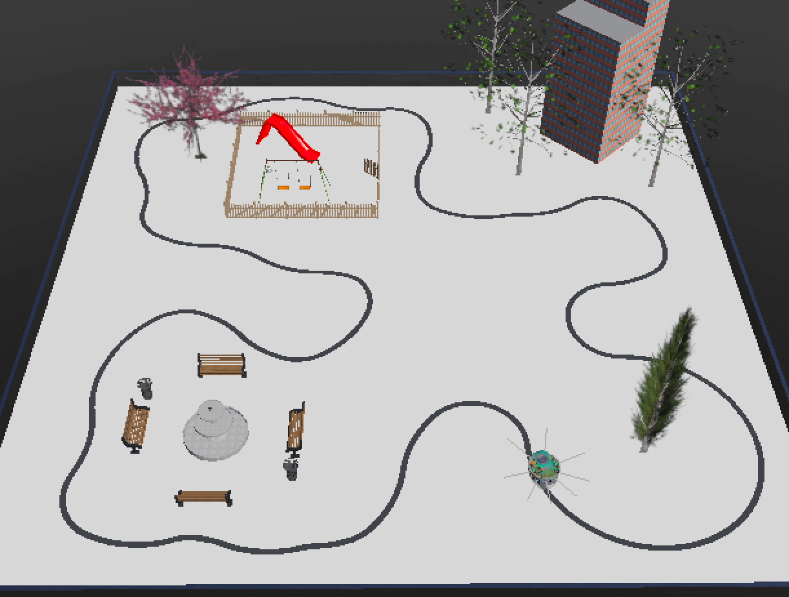
Demonstration of the robot (video)

